Slide 1
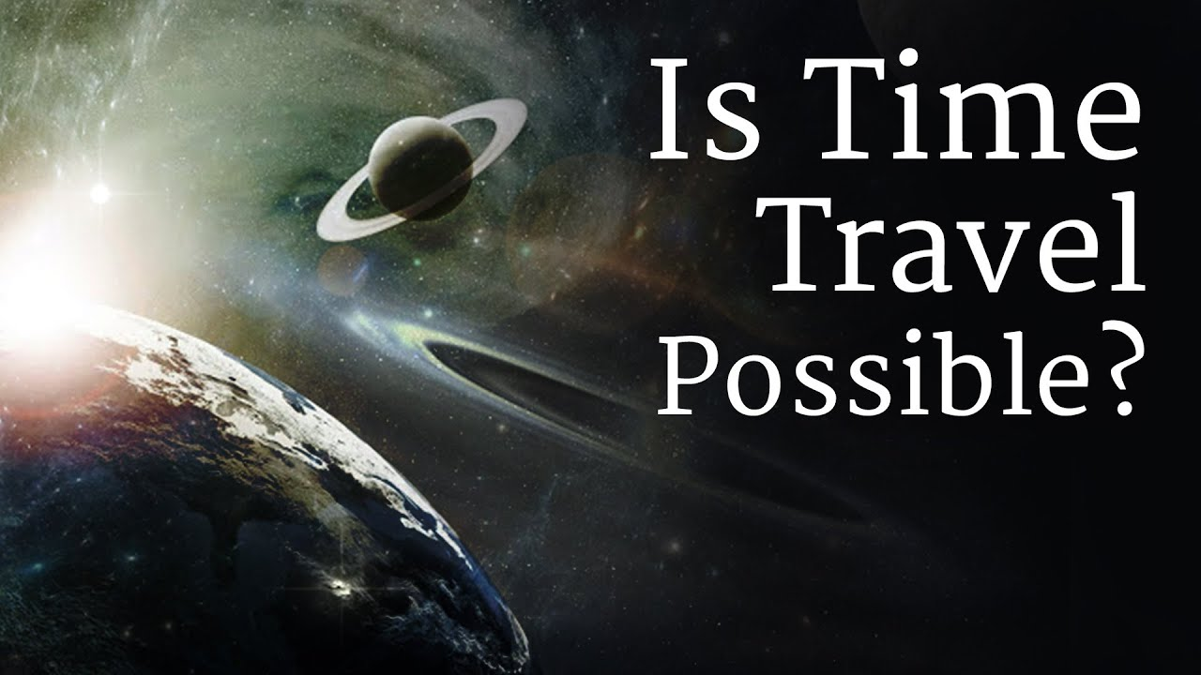

Slide 2
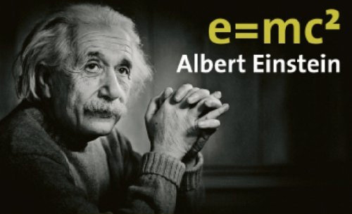

Albert Einstein showed that time is an illusion
According to the theory, the faster you travel, the slower you experience time. Time passes faster for your face than for your feet (assuming you're standing up). Einstein's theory of relativity dictates that the closer you are to the centre of the Earth, the slower time goes – and this has been measured

Slide 3
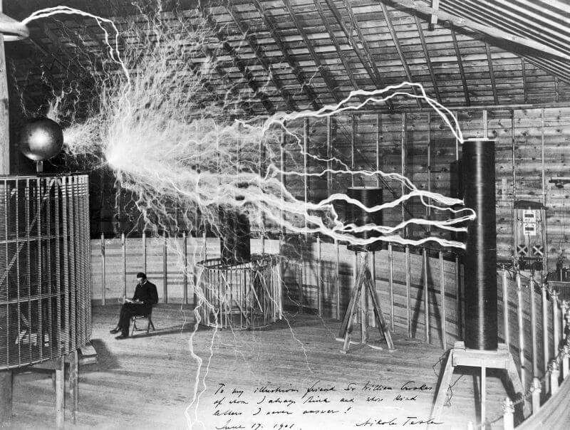
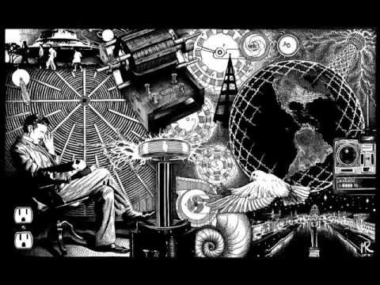
Nikola Tesla and time travel
Nikola Tesla had written in 1932. about neutron who can travel faster than sunlight.
He constructed a tower in New Jersey to communicate with aliens.

Slide 4
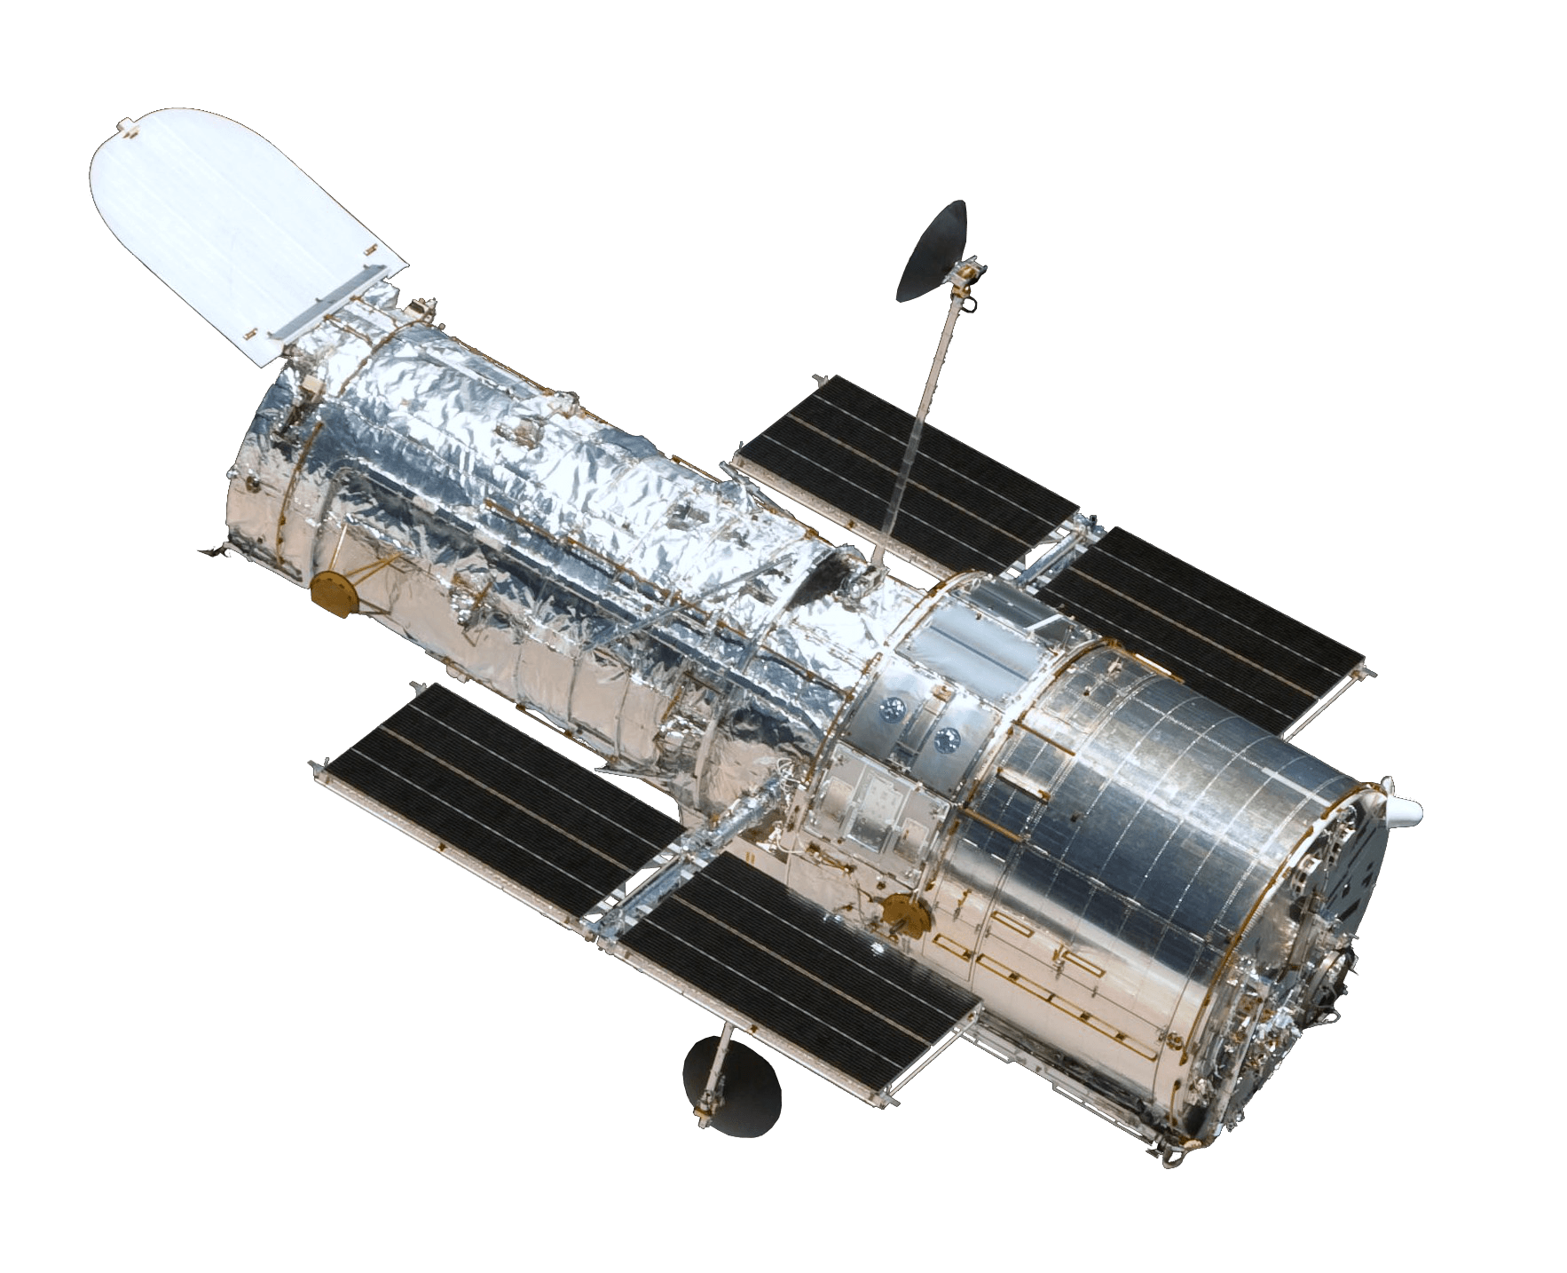


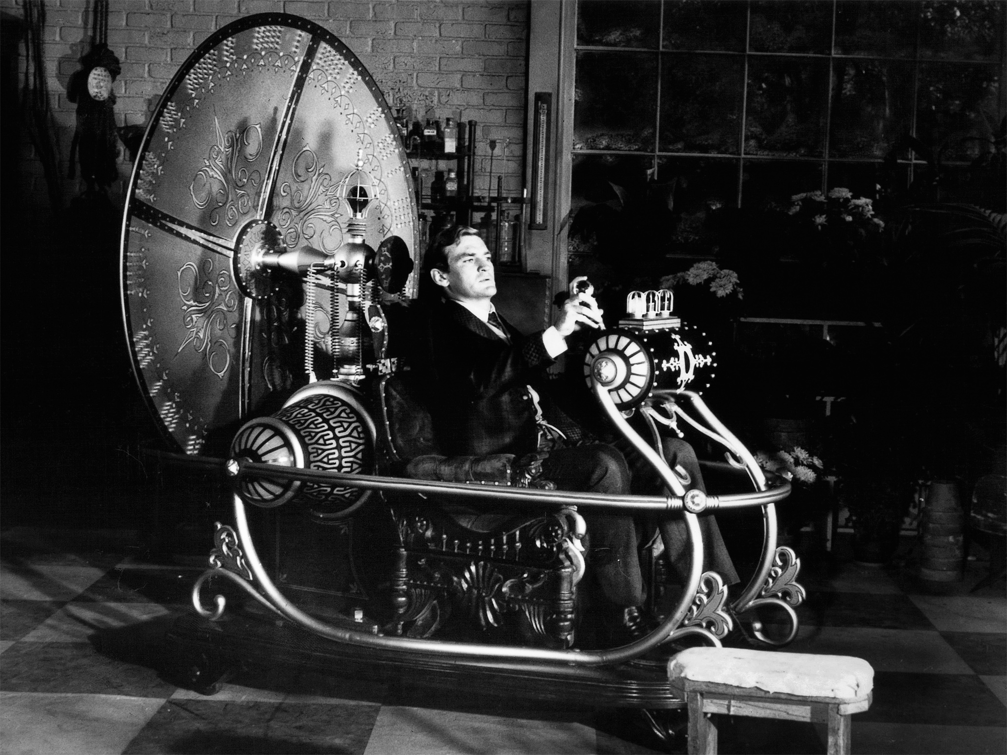
Time machine
It is generally understood that traveling forward or back in time would require a device — a time machine — to take you there.
NASA's space telescopes also give us a way to look back in time. Telescopes help us see stars and galaxies that are very far away.

Slide 5
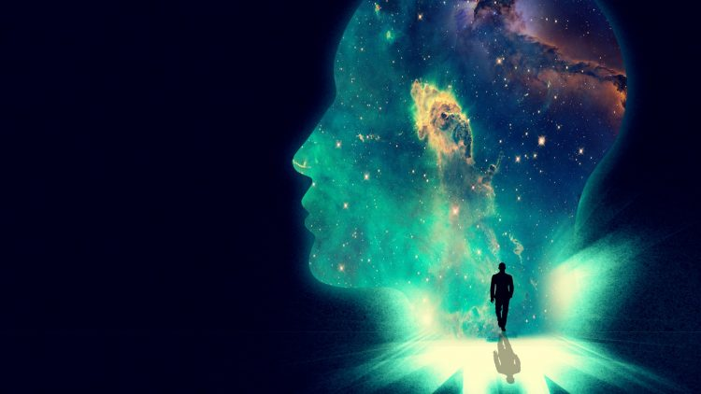
PARALELL UNIVERSUM
PRESENT
FUTURE
PAST

Slide 6
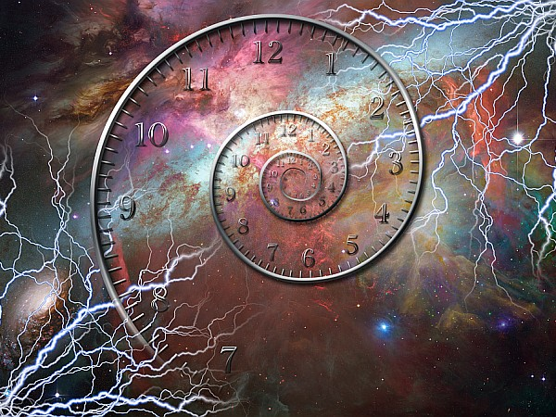
If you ask modern physics, time travel is not possible.
The reality, however, is more muddled. Not all scientists believe that time travel is possible. Some even say that an attempt would be fatal to any human who chooses to undertake it.

Slide 7

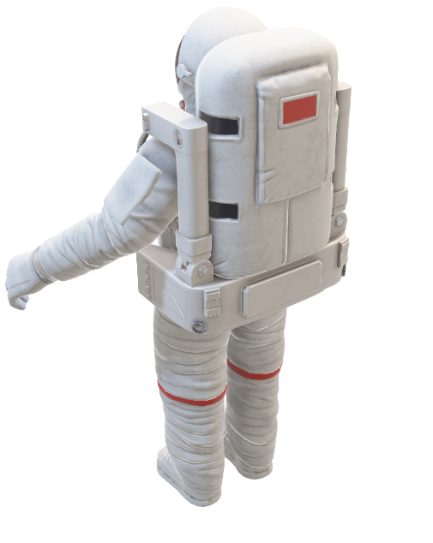
TWIN PARADOX
Example of traveling into the future

Slide 8

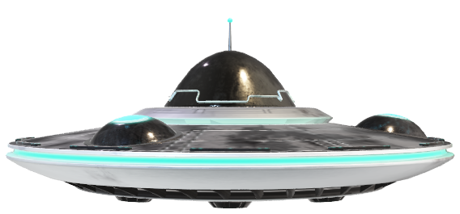
One button can change future? right?
Not quite
This is because then future-you wouldn't have decided to time travel in the first place.
For decades, physicists have been studying and debating versions of this paradox: If we could travel back in time and change the past, what would happen to the future?
BUT

Slide 9
Imagine you could hop into a time machine, press a button, and journey back to 2019
2020
2019

Slide 10

Thank you for your
Presentation done by:
Viktor Cvetanovic
Jovana jovanovic

